Slide 1
Customer
Churn Analysis
SANJAY KANNAN

Slide 2
Business understanding and Overview
In this Churn Analysis EDA, we aim to delve into a dataset that captures customer information, service usage, and churn behavior. The primary objectives of this analysis are to:
Understand the distribution of churn across different customer segments.
Identify potential patterns and factors that correlate with higher churn rates.
Explore the relationships between various features and churn behavior.

Slide 3
Understanding the Data

Slide 4
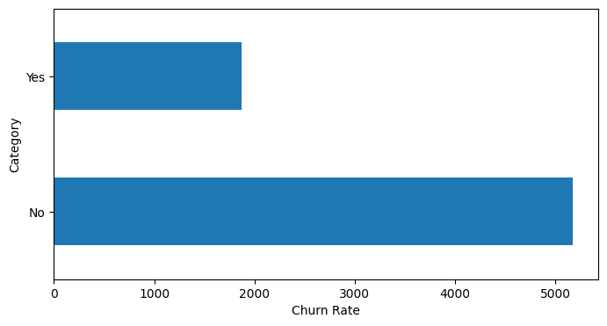
Target Variable
In this Churn Analysis Exploratory Data Analysis (EDA), the target variable is likely to be the "Churn" column.
The "Churn" column typically indicates whether a customer has discontinued or "churned" their subscription or service with the company (e.g., moved to another provider, canceled their subscription).

Slide 5
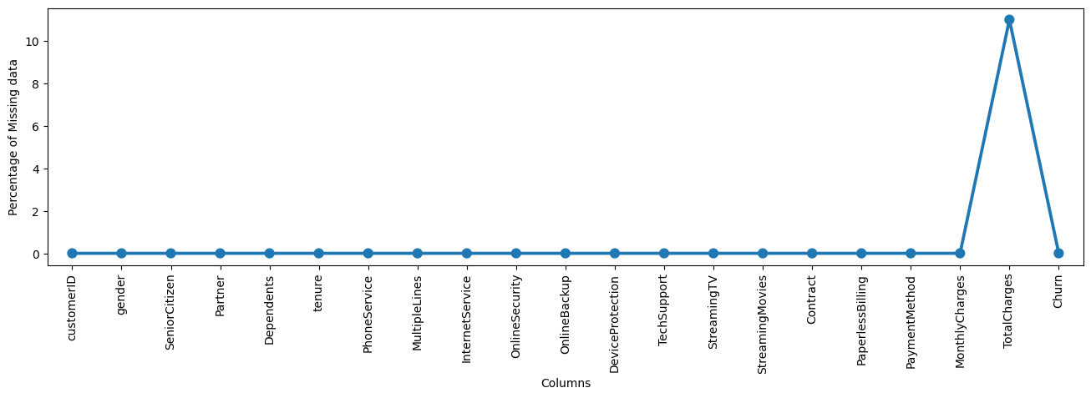
Missing Data
The given dataset contains instances with missing values only in the "TotalCharges" column.
These gaps in data might arise due to diverse factors, such as incomplete billing records or data entry inconsistencies.
Prior to engaging in any analyses involving the "TotalCharges" variable, it is imperative to establish a well-considered strategy for managing these missing values.
Common strategies encompass imputation of missing values using methods like mean, median, or contextually relevant values, or alternatively, evaluating the appropriateness of excluding rows with missing values based on the specific analytical context.

Slide 6
Categorical Analysis

Slide 7
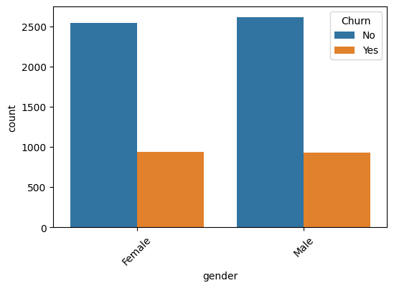
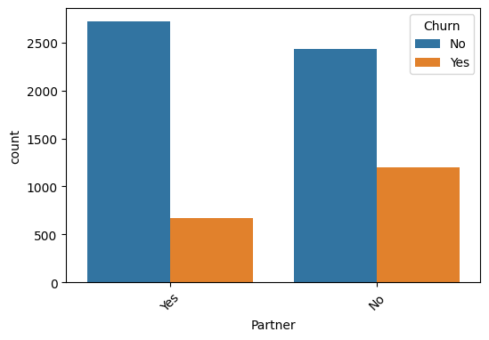
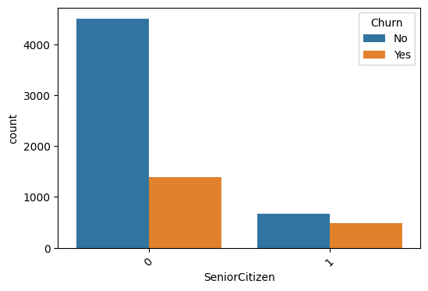
Univariate Analysis
Univariate analysis entails the examination of individual variables in isolation to comprehend their distribution, central tendencies, and unique characteristics.
Through this methodical exploration, we can glean insights into the behavior of each variable, decipher its frequency, detect outliers, and identify patterns that might lay the groundwork for further analyses and decision-making.

Slide 8
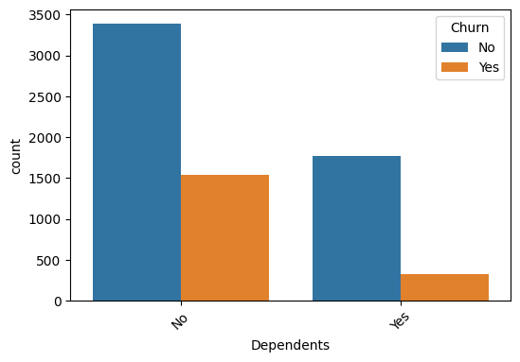
Dependents vs Target variable
A noteworthy observation emerges: customers lacking dependents display a higher likelihood of churning.
This discernible trend highlights the potential impact of familial dynamics on customer retention.

Slide 9
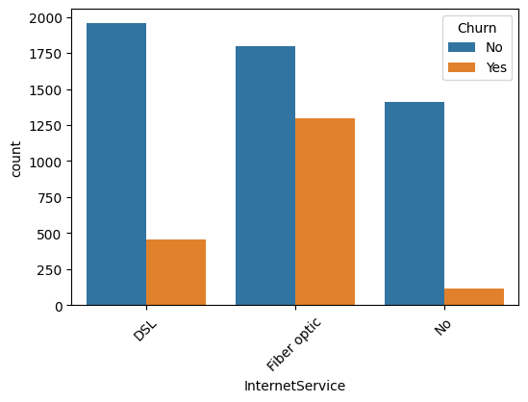
Internet services vs Target variable
Customers who have opted for fiber optic services exhibit a higher propensity for churn, suggesting a noteworthy correlation between the choice of service and churn behavior.

Slide 10
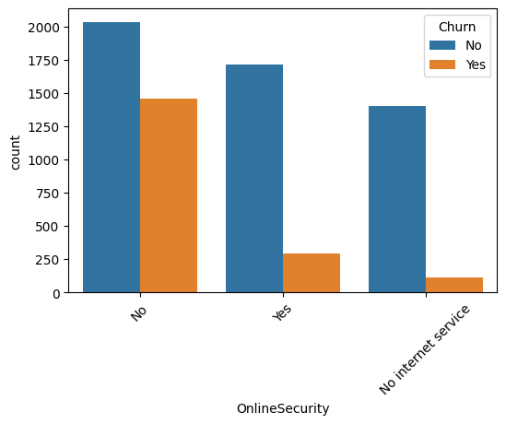
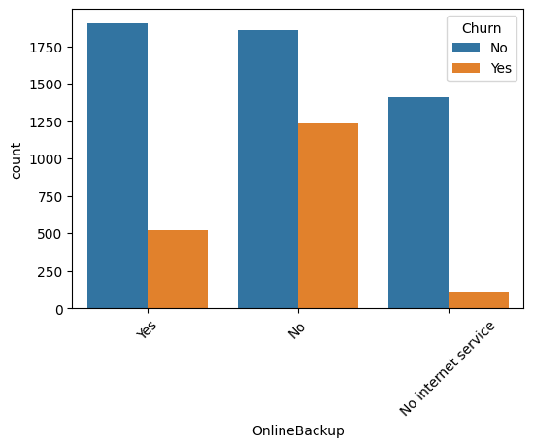
Online Security and Online Backup vs Target Variable
Customers lacking online security features exhibit a heightened likelihood of churning, underscoring the significance of safeguarding digital assets.
The absence of online backup services emerges as a contributing factor to customer churn, emphasizing the importance of data protection measures.

Slide 11

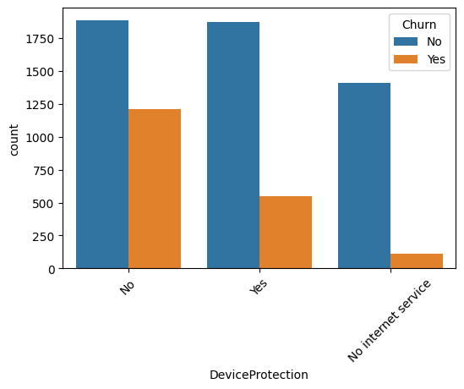
Device protection and Tech support vs Target variable
Customers devoid of device protection exhibit an elevated likelihood of churning, suggesting the potential significance of this service in fostering customer retention.
Absence of tech support among customers is associated with an increased propensity for churn, underscoring the role of comprehensive support services in mitigating attrition.

Slide 12
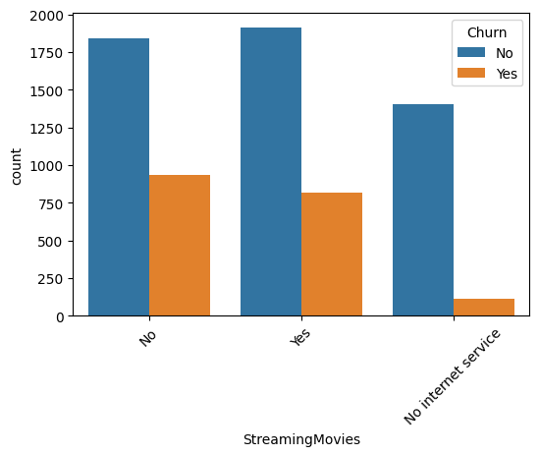
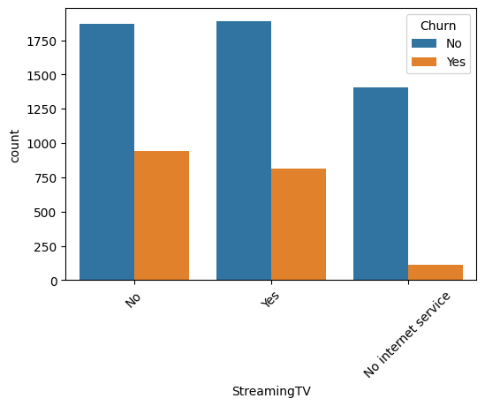
Streaming TV and Streaming Movies vs Target variable
The churn rates for users and non-users of both streaming TV and streaming movies exhibit a remarkably balanced distribution, reflecting a consistent pattern across these services.

Slide 13
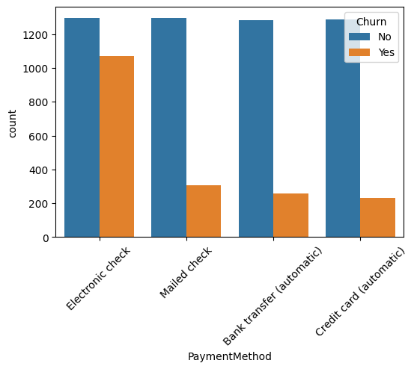
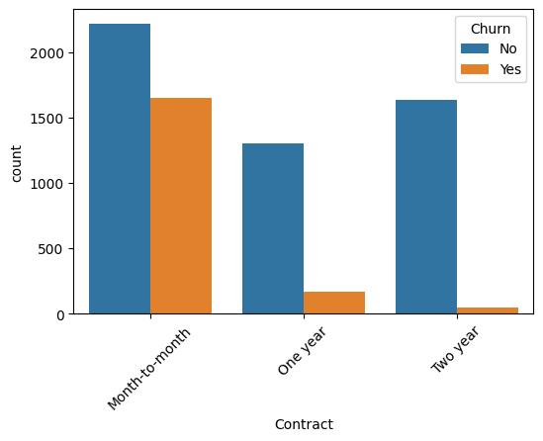
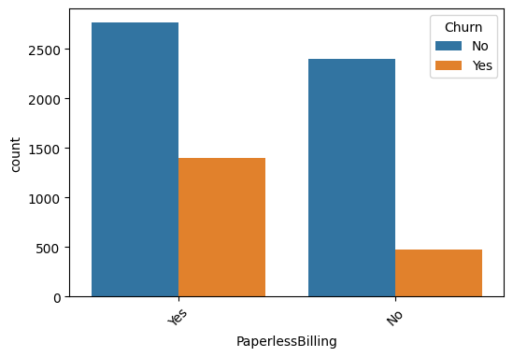
Contract, Payment method and paperless billing vs Target value
Month-to-month contractual agreements exhibit a notable propensity for higher churn rates.
Clients who opt for paperless billing appear to exhibit a comparatively elevated churn rate.
"Remarkably, a discernible pattern emerges when scrutinizing customer payment methods. Notably, those who opt for electronic cheque payments exhibit a pronounced tendency towards elevated churn rates.

Slide 14
Numerical Analysis

Slide 15
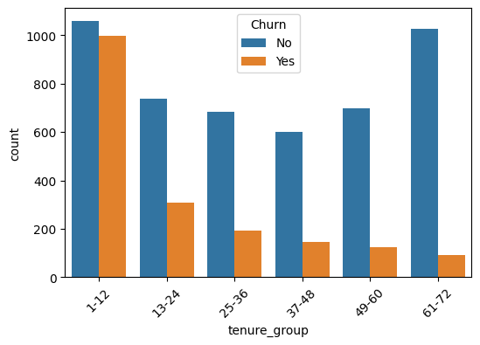
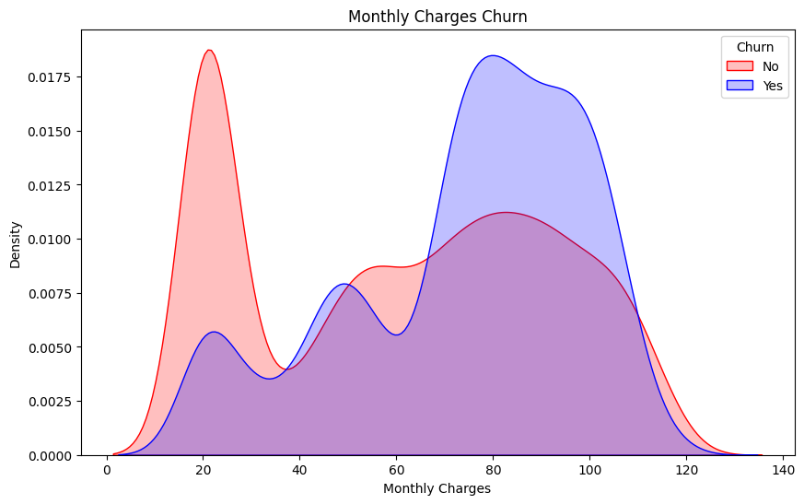
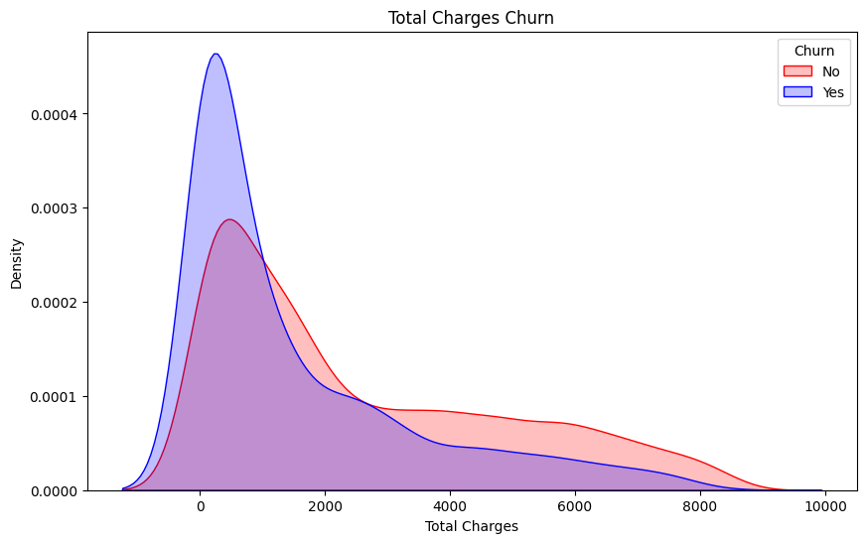
Correlation between numerical columns
Customers exhibiting a convergence of higher monthly charges, shorter tenure durations, and comparatively lower total charges appear to demonstrate an increased propensity for churn.
This alignment suggests an intricate interplay between pricing dynamics, customer longevity, and overall expenditure, underscoring the potential influence of these factors on churn behavior.

Slide 16
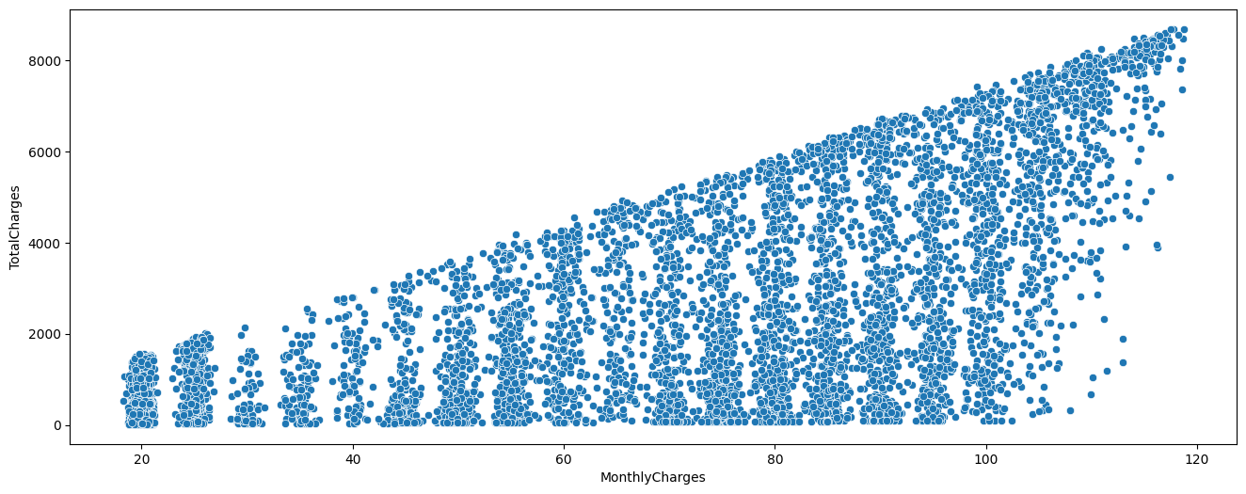
Correlation - Scatter plot
Monthly charges and Total charges has a positive correlation.

Slide 17
Bivariate Analysis

Slide 18
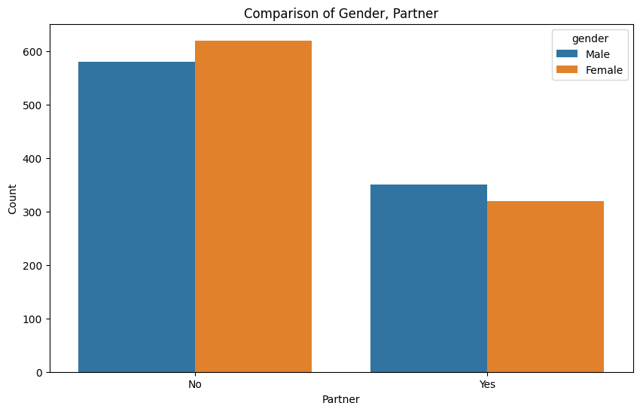
Gender vs Partner : Churn
Female client who lack partnership affiliations exhibit a heightened proclivity towards churning, underlining the significance of this demographic distinction in churn dynamics.

Slide 19
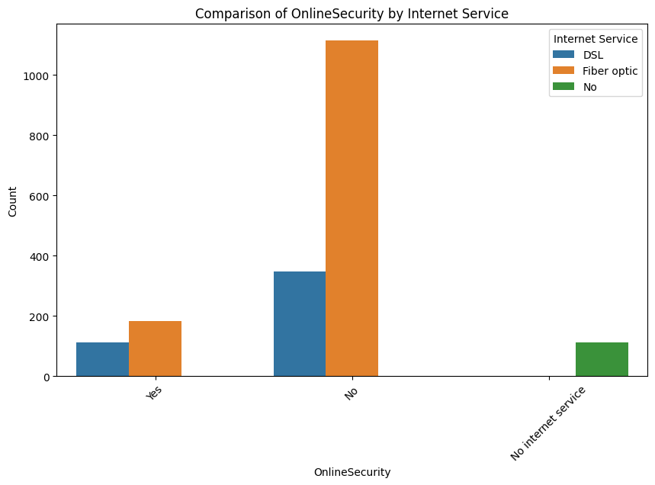
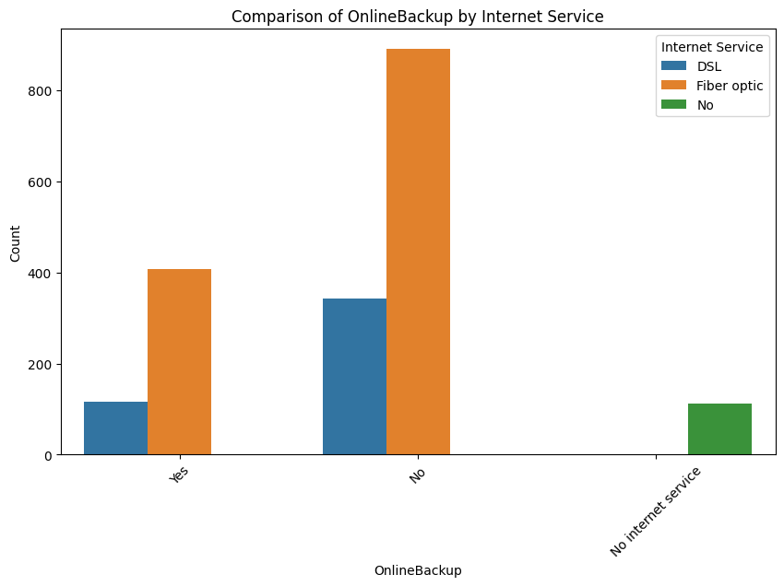
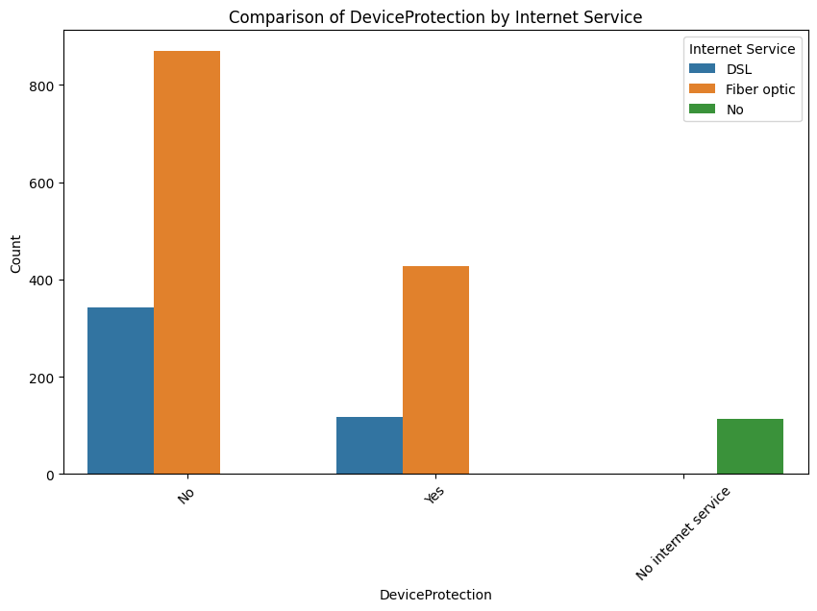
Online Security vs Online Backup vs Device Protection: Churn
Online Security and Fiber Optic Usage:
Absence of online security measures, particularly when using fiber optic connections, significantly increases the likelihood of churn.
The correlation between the absence of online security and the choice of fiber optic services underscores the importance of addressing security concerns to retain customers.
Online Backup and Fiber Optic Usage:
The absence of online backup features, notably in conjunction with fiber optic services, presents a substantial risk for increased churn rates.
Highlighting the potential link between the lack of online backup and fiber optic usage emphasizes the need to provide reliable data backup options to customers.
Device Protection and Fiber Optic Usage:
Customers without device protection, particularly when utilizing fiber optic services, exhibit a notably higher propensity for churn.
Recognizing the connection between the absence of device protection and the choice of fiber optic services accentuates the significance of safeguarding customers' devices for retention.

Slide 20
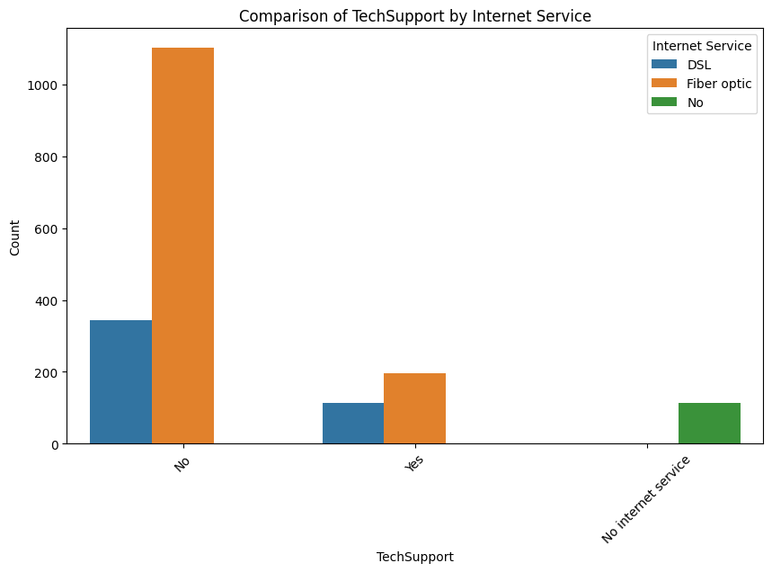
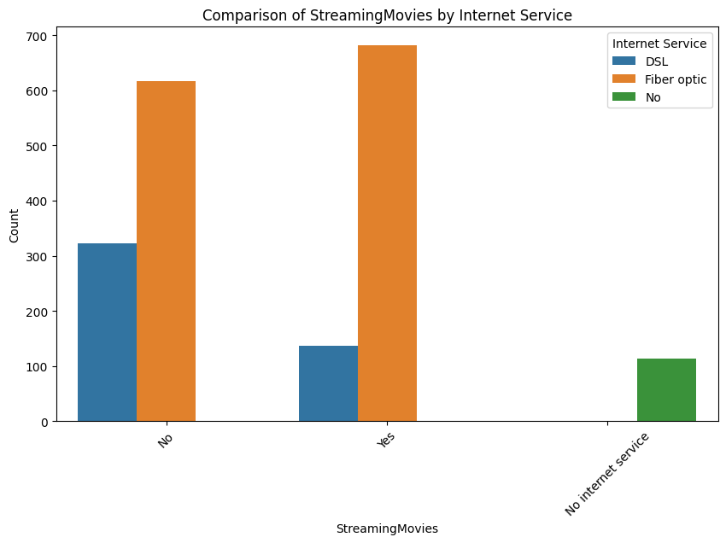
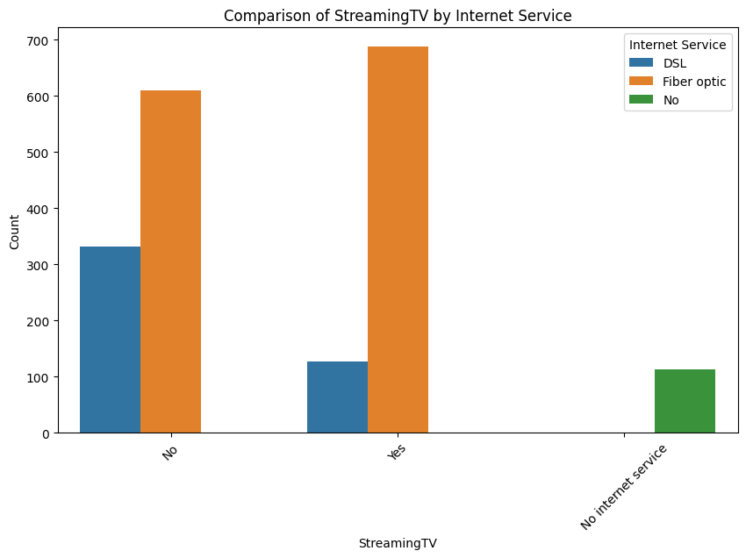
Tech support vs Streaming Tv vs Streaming Movies : Churn
Tech Support and Fiber Optic Usage:
The absence of access to tech support, especially in the context of fiber optic usage, is strongly associated with an elevated likelihood of churn.
The strong relationship between the lack of tech support and fiber optic service usage highlights the necessity of robust customer support systems.
Streaming Services and Fiber Optic Usage:
Both users and non-users of streaming TV and movies, when utilizing fiber optic services, exhibit a higher inclination towards churn.
The prevalence of churn tendencies among users and non-users of streaming services, in conjunction with fiber optic usage, underscores the importance of holistic customer engagement strategies.

Slide 21
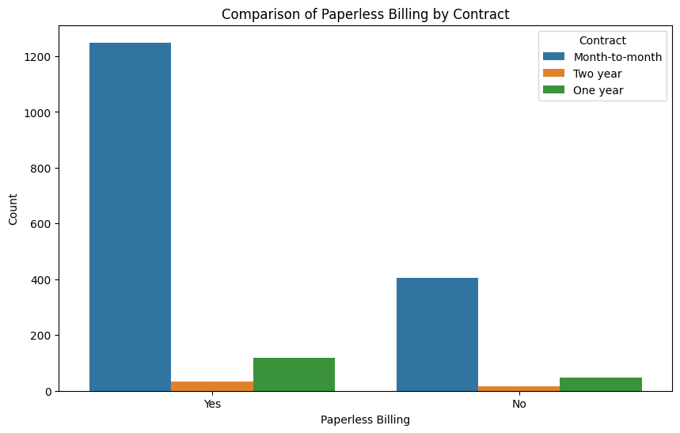
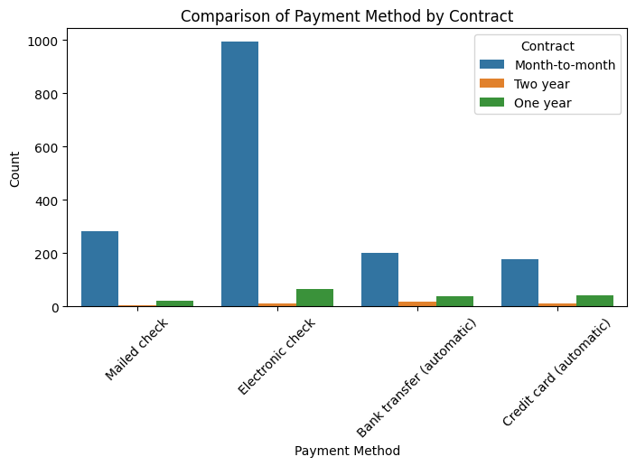
Paperless billing vs Payment method vs Contract : Churn
Regarding Month-to-Month Contracts with Paperless billing:
Customers on month-to-month contracts who opt for paperless billing exhibit a higher propensity for churn, signifying a potential area for targeted retention strategies.
In the Context of Month-to-Month Contracts with Payment method:
Similarly, month-to-month contract customers who utilize electronic cheque payment methods display an elevated likelihood of churn, warranting strategic focus on mitigating this trend.

Slide 22
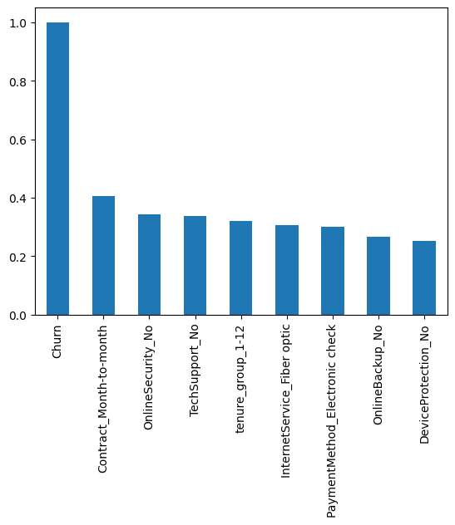
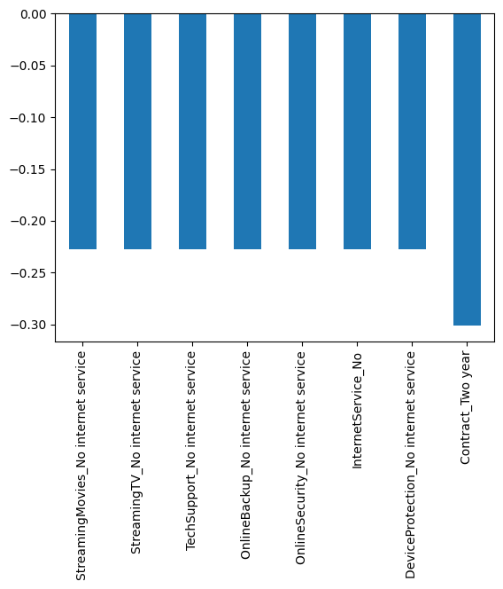
Correlations in the dataset with respect to Churn
Correlation > 0.2
Correlation < -0.2

Slide 23
Final Results :
Month to Month contract customers who are using :
Paperless billing users
Electronic cheque payment method
Are more likely to churn.
Fibre optic internet service customers who are “NOT” using :
Online Security
Online backup
Device protection
Tech support
Are more likely to churn.
Female customers who “don’t have” :
Partners
Are more likely to churn.
Tenure 0-12 with :
High monthly charges
Less total charges
Are more likely to churn.
In general, Customers who are not using internet and who are in two year contracts are very less likely to churn.

Slide 24
What next?
Possible solutions :
Offer some crazy deals or gifts to month to month contract customers especially from 0 - 12 months.
For the first 12 months, try to reduce the monthly charges so that at the end of the year, they won’t feel mad about the total cost.
Fibre optic users are paying more but having less features because, they are not using online security and backup, device protection and Tech support. Try to split and have some extra package plans based on the customers need. For example,
Fibre optic + online backup + online security = $ ????
Fibre optic + device protection + Tech support = $ ????
Give some exclusive offers to the female customers who lack of partner. For example,
If they are students, give some useful gifts based on their tenure like 0 - 6 : Free mobile case, 7 - 12 : Free 1 month service, 13 - 30 : Free airpods or airbuds or headphones.
If they are workers, give some gifts like 0 - 12 : Free 3 month MS office or something else, 13 - 30 : Free gift cards
Meanwhile, offer some attractive plans for all the customers.

